Slide 1
Distributed Database Design

Slide 2
Concerns for the Distributed Design
Placement of data across sites
Designing the network
Distribution of the DBMS software
Distribution of application programs

Slide 3
Design Process: Fragmentation
Relation R
Fragment 1
Fragment 3
Fragment 2
Site 1
Site 3
Site 2

Slide 4
Reasons to Fragment
Application views are only subset of relations
Locality of access
Concurrent or parallel execution of transactions

Slide 5
Disadvantages of fragmentation
May suffer from performance degradation
Attributes participating in Dependency may belong to different fragments

Slide 6
How should we fragment ?
PROJ
PNO | PNAME | BUDGET | LOC
P1 | Instrumentation | 15000 | Kolkata
P2 | Database Developer | 13000 | Mumbai
P3 | Coder | 25000 | Mumbai
P4 | Maintenance | 31000 | Delhi

Slide 7
Horizontal fragmentation
Proj 1
PNO | PNAME | BUDGE | LOC
P1 | Instrumentation | 15000 | Kolkata
P2 | Database Developer | 13000 | Mumbai
Proj 2
PNO | PNAME | BUDGE | LOC
P3 | Coder | 25000 | Mumbai
P4 | Maintenance | 31000 | Delhi

Slide 8
Vertical Fragmentation
Proj1
PNO | BUDGET
P1 | Kolkata
P2 | Mumbai
P3 | Mumbai
P4 | Delhi
Proj2
PNO |  | PNAME | LOC
P1 | Instrumentation | 15000 | Kolkata
P2 | Database Developer | 13000 | Mumbai
P3 | Coder | 25000 | Mumbai
P4 | Maintenance | 31000 | Delhi

Slide 9
Degree of Fragmentation
Not to fragment at all
Fragment to individual level

Slide 10
Correctness Rules of Fragmentation
Completeness : Lossless decomposition
Reconstruction : Constraints preservation
Disjointness

Slide 11
Allocation Alternatives
Partitioned Database
Fully replicated Database
Partially replicated Database

Slide 12
Horizontal fragmentation
Horizontal Fragmentation has two variants
Primary Horizontal Fragmentation (PHF)
Derived Horizontal Fragmentation (DHF)

Slide 13
Primary Horizontal Fragmentation (PHF)
Fragmenting a single table horizontally (row wise) using a set of simple predicates
Simple Predicate> Given a table R [A₁, A₂, …, A_{n}], a simple predicate P_{i}
P_{i} = A_{j} θ Value
Where θ 🡪 {=, <, >, ≤, ≥, ≠}
value is domain of the attributed Aj.

Slide 14
Primary Horizontal Fragmentation (PHF)
Account
Acno | Balance | Branch_Name
A101 | 5000 | Mumbai
A103 | 10000 | New Delhi
A104 | 2000 | Chennai
A102 | 12000 | Chennai
A110 | 6000 | Mumbai
A115 | 6000 | Mumbai
A120 | 2500 | New Delhi

Slide 15
Primary Horizontal Fragmentation (PHF)
Set of simple predicates
For a table R, set of simple predicate can be defined as
P = { P₁, P₂, …, P_{n}}
Example 1
Set of simple predicates P1 = {Balance < 10000, Balance ≥ 10000}
Example 2
Set of simple predicates P2 = { Branch_name = ‘Chennai’, Branch_name= ‘Mumbai’, Balance < 10000, Balance ≥ 10000}

Slide 16
Primary Horizontal Fragmentation (PHF)
Min-term Predicate
Fragment, R_{i} = σ_{Fi}(R), 1 ≤ i ≤ n
Here F_{i} is the set of simple predicates represented in conjunctive normal form also called Min-term predicate
Min-term predicate, M_{i}=P₁ Λ P₂ Λ P₃ Λ … Λ P_{n}
Here, P₁ means both P₁ or ¬(P₁),

Slide 17
Primary Horizontal Fragmentation (PHF)
P1 = {Balance < 10000, Balance ≥ 10000}
2 simple predicates in P1 gives (2²) minterm predicates
m₁ = {Balance < 10000 Λ Balance ≥ 10000}
m₂ = {Balance < 10000 Λ ¬(Balance ≥ 10000)}
m₃ = {¬(Balance < 10000) Λ Balance ≥ 10000}
m₄ = {¬(Balance < 10000) Λ ¬(Balance ≥ 10000)}

Slide 18
Primary Horizontal Fragmentation (PHF)
Account₁ = σBalance< 10000 Λ Balance ≥ 10000(Account)
SELECT * FROM account WHERE balance < 10000 AND balance ≥ 10000;
Account₂ = σBalance< 10000 Λ ¬(Balance ≥ 10000)(Account)
SELECT * FROM account WHERE balance < 10000 AND NOT balance ≥ 10000;

Slide 19
Primary Horizontal Fragmentation (PHF)
Account₃ = σ¬(Balance< 10000) Λ Balance ≥ 10000(Account)
SELECT * FROM account WHERE NOT balance < 10000 AND balance ≥ 10000;
Account₄ = σ¬(Balance< 10000) Λ ¬(Balance ≥ 10000)(Account)
SELECT * FROM account WHERE NOT balance < 10000 AND NOT balance ≥ 10000;

Slide 20
Primary Horizontal Fragmentation (PHF)
Account₂
(Minterm Fragment 1)
Acno | Balance | Branch_Name
A101 | 5000 | Mumbai
A104 | 2000 | Chennai
A120 | 2500 | New Delhi
A110 | 6000 | Mumbai
A115 | 6000 | Mumbai
Account₃
(Minterm Fragment 2)
Acno | Balance | Branch_Name
A103 | 10000 | New Delhi
A102 | 12000 | Chennai

Slide 21
Primary Horizontal Fragmentation (PHF)
Completeness –
(SELECT * FROM account2) Union (SELECT * FROM account3) -🡪 Account
Reconstruction –
Disjointness –
(SELECT * FROM account2) Intersect (SELECT * FROM account3) = NULL

Slide 22
Primary Horizontal Fragmentation (PHF)
P2 = Set of Simple Predicates= { Branch_name = ‘Chennai’, Branch_name= ‘Mumbai’, Balance < 10000, Balance ≥ 10000}
How many total Minterm predicates we will have ??
What are the valid Minterm Predicates??

Slide 23
m₁ = { Branch_name = ‘Chennai’ Λ ¬(Branch_name= ‘Mumbai’) Λ ¬(Balance < 10000) Λ Balance ≥ 10000}
m₂ = { Branch_name = ‘Chennai’ Λ ¬(Branch_name= ‘Mumbai’) Λ Balance < 10000 Λ ¬(Balance ≥ 10000)}
m₃ = { ¬(Branch_name = ‘Chennai’) Λ Branch_name= ‘Mumbai’ Λ ¬(Balance < 10000) Λ Balance ≥ 10000}
m₄ = { ¬(Branch_name = ‘Chennai’) Λ Branch_name= ‘Mumbai’ Λ Balance < 10000 Λ ¬(Balance ≥ 10000)} m₅ = { ¬(Branch_name = ‘Chennai’) Λ ¬(Branch_name= ‘Mumbai’) Λ ¬(Balance < 10000) Λ Balance ≥ 10000}
m₆ = { ¬(Branch_name = ‘Chennai’) Λ ¬(Branch_name= ‘Mumbai’) Λ Balance < 10000 Λ ¬(Balance ≥ 10000)}

Slide 24
Fragment 1: SELECT * FROM account WHERE branch_name = ‘Chennai’
AND balance ≥ 10000;
Acno | Balance | Branch_Name
A102 | 12000 | Chennai
Fragment 2: SELECT * FROM account WHERE branch_name = ‘Chennai’
AND balance < 10000;
Acno | Balance | Branch_Name
A102 | 2000 | Chennai
Fragment 3: SELECT * FROM account WHERE branch_name = ‘Mumbai’
AND balance ≥ 10000;
Acno | Balance | Branch_Name

Slide 25
Fragment 4: SELECT * FROM account WHERE branch_name = ‘Mumbai’
AND balance < 10000;
Acno | Balance | Branch_Name
A101 | 5000 | Mumbai
A110 | 6000 | Mumbai
A115 | 6000 | Mumbai

Slide 26
Fragment 5: SELECT * FROM account WHERE branch_name <> ‘Mumbai’
AND branch_name <> ‘Chennai’ AND balance ≥ 10000;
Acno | Balance | Branch_Name
A103 | 10000 | New Delhi
Fragment 6: SELECT * FROM account WHERE branch_name <> ‘Mumbai’
AND branch_name <> ‘Chennai’ AND balance < 10000;
Acno | Balance | Branch_Name
A120 | 2500 | New Delhi

Slide 27
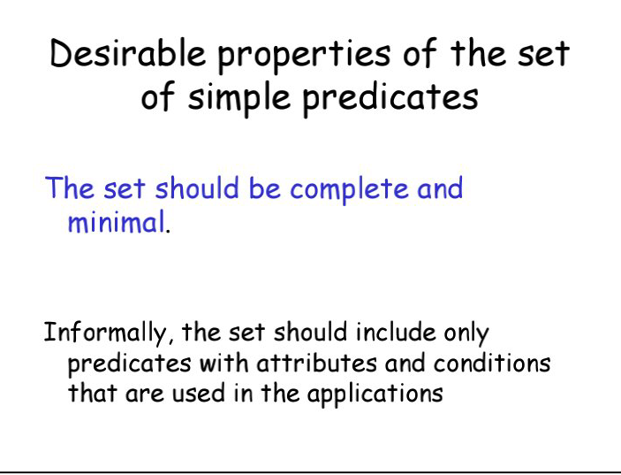

Slide 28
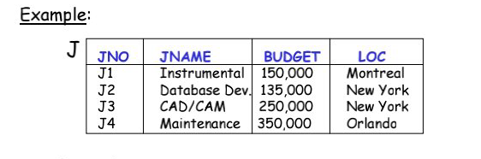

Slide 29
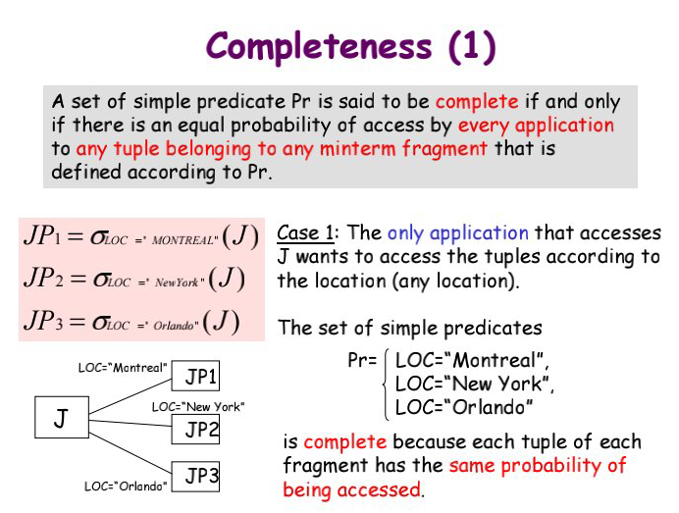

Slide 30
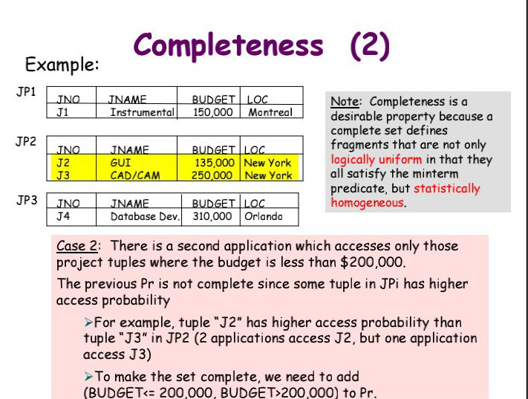

Slide 31
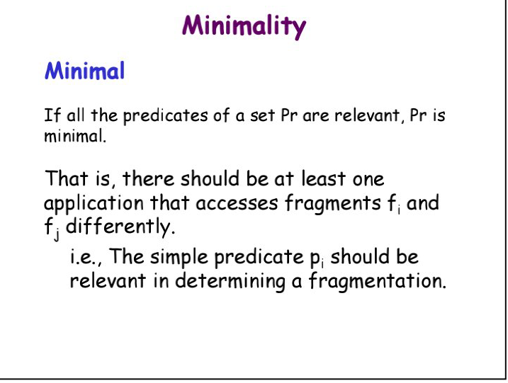

Slide 32
Semijoin (Relational Algebra)
Semi-join (⋉)(⋊)
The left semijoin R ⋉ S ,
where R and S are relations.
The result is the set of all tuples in R for which there is a tuple in S that is equal on their common attribute names.
The difference from a natural join is that other columns of S do not appear.

Slide 33
Semijoin (Relational Algebra)
Employee
Name | EmpId | DeptName
Harry | 3415 | Finance
Sally | 2241 | Sales
George | 3401 | Finance
Harriet | 2202 | Production
Dept
DeptName | Manager
Sales | Sally
Production | Harriet

Slide 34
Semijoin (Relational Algebra)
Employee ⋉ Dept
Name | EmpId | DeptName
Sally | 2241 | Sales
Harriet | 2202 | Production
The difference from a natural join is
that other columns of S do not appear.

Slide 35
Derived Horizontal Fragmentation
The process of creating horizontal fragments of a table based on the already created horizontal fragments of another relation (base table) is called Derived Horizontal Fragmentation.

Slide 36
Derived Horizontal Fragmentation
CUSTOMER(CId, CName, Prod_Purchased, Shop_Location)
C_ADDRESS(CId, C_Address)
Here, CUSTOMER is the owner relation and C_ADDRESS is the member relation.

Slide 37
DHF Contd.
CUSTOMER table
CID | CNAME | PROD_PURCHASED | SHOP_LOCATION
C001 | Ram | Air Conditioner | Mumbai
C002 | Guru | Television | Chennai
C010 | Murugan | Television | Coimbatore
C003 | Yuvraj | DVD Player | Pune
C004 | Gopinath | Washing machine | Coimbatore

Slide 38
DHF Contd.
C_ADDRESS table
CID | C_ADDRESS
C001 | Bandra, Mumbai
C001 | XYZ, Pune
C002 | T.Nagar, Chennai
C002 | Kovil street, Madurai
C003 | ABX, Pune
C004 | Gandhipuram, Ooty
C004 | North street, Erode
C010 | Peelamedu, Coimbatore

Slide 39
CUSTOMER₁
CID | CNAME | PROD_PURCHASED | SHOP_LOCATION
C001 | Ram | Air Conditioner | Mumbai
CUSTOMER₂
CID | CNAME | PROD_PURCHASED | SHOP_LOCATION
C002 | Guru | Television | Chennai
CUSTOMER₃
CID | CNAME | PROD_PURCHASED | SHOP_LOCATION
C010 | Murugan | Television | Coimbatore
C004 | Gopinath | Washing machine | Coimbatore
CUSTOMER4
CID | CNAME | PROD_PURCHASED | SHOP_LOCATION
C003 | Yuvraj | DVD Player | Pune

Slide 40
The fragmentation of C_ADDRESS is done as follow as set of semi-joins as follows.
C_ADDRESS₁ = C_ADDRESS ⋉ CUSTOMER₁
C_ADDRESS₂ = C_ADDRESS ⋉ CUSTOMER₂
C_ADDRESS₃ = C_ADDRESS ⋉ CUSTOMER₃
C_ADDRESS₄ = C_ADDRESS ⋉ CUSTOMER₄

Slide 41
C_ADDRESS₁
CID | C_ADDRESS
C001 | Bandra, Mumbai
C001 | XYZ, Pune
C_ADDRESS₂
CID | C_ADDRESS
C002 | T.Nagar, Chennai
C002 | Kovil street, Madurai
C_ADDRESS₃
CID | C_ADDRESS
C004 | Gandhipuram, Ooty
C004 | North street, Erode
C010 | Peelamedu, Coimbatore
C_ADDRESS₄
CID | C_ADDRESS
C003 | ABX, Pune

Slide 42
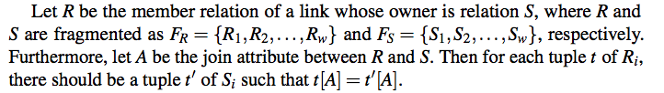
Checking for correctness
Completeness:
For example, the value present in CID of CUSTOMER₁ is also and only present in C_ADDRESS₁, etc.
Reconstruction: Reconstruction of a relation from its fragments is performed by the union operator in both the primary and the derived horizontal fragmentation.
Disjointness: In our example, as the simple predicates Shop_Location=’Mumbai’, etc are mutually exclusive, the derived fragments are also disjoint.

Slide 43
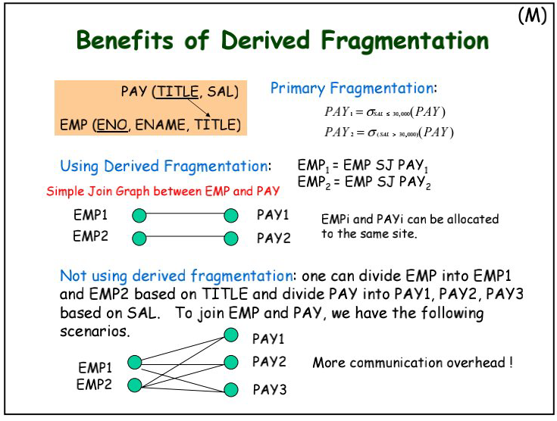

Slide 44
Vertical Data Fragmentation :
This is the vertical subset of a relation.
That means a relation / table is fragmented by considering the columns of it.
The lower limit of vertical fragmentation is a single attribute
Key attribute is repeated in the fragments, which helps in joins

Slide 45
Vertical Data Fragmentation :
deposit₁ = Πbranch_name, customer_name, tuple_id (employee_info )
branch_name | customer_name | tuple_id
Hillside Hillside Valleyview Valleyview Hillside Valleyview Valleyview | Lowman Camp Camp Kahn Kahn Kahn Green
1
2
3
4
5
6
7

Slide 46
Vertical Data Fragmentation :
deposit₂ = Πaccount_number, balance, tuple_id (employee_info )
account_number | balance | ttuple_id
A-305 A-226 A-177 A-402 A-155 A-408 A-639 | 500 336 205 10000 62 1123 750
1
2
3
4
5
6
7

Slide 47
Vertical Data Fragmentation :Correctness:
Lossless decomposition: Each attribute of R belongs to at least one fragment; each fragment includes either a key of R or a “tuple identifier”.
Reconstruction (using join operators)
Disjointness for non-key attributes (not part of
primary keys)

Slide 48
Objective of Vertical Fragmentation
Minimization of Execution time that run on these fragments
Allows tuples to be split so that each part of the tuple is stored where it is most frequently accessed
Tuple-id attribute allows efficient joining of vertical fragments
Allows parallel processing on a relation

Slide 49
Hybrid fragmentation
Hybrid fragmentation can be done in two alternative ways
At first, generate a set of horizontal fragments; then generate vertical fragments from one or more of the horizontal fragments.
At first, generate a set of vertical fragments; then generate horizontal fragments from one or more of the vertical fragments.

Slide 50
Hybrid fragmentation
R
H
H
R1
R2
V
V
V
V
V
R23
R11
R21
R22
R12

Slide 51
Hybrid fragmentation
To reconstruct the global relation in case of hybrid fragmentation, start at leaves of the partitioning tree, and moves upward by performing joins and unions

Slide 52
Hybrid fragmentation:Reconstruction
U
⋈
⋈
R23
R11
R21
R22
R12

Slide 53
Hybrid fragmentation
Completeness : Fragmentation is completed if the intermediate and leaf fragments are complete.
Disjointness: Intermediate and leaf fragments should be disjoint

Slide 54
Advantages of Fragmentation
Efficiency
Data is stored close to where it is most frequently used. In addition, data that is ,not needed by’ local applications is not stored.
Parallelism
With fragments as the unit of distribution, a transaction can be divided into several sub queries that operate on fragments.
Security
Data not required by local applications is not stored, and consequently not available to unauthorized users.

Slide 55
Disadvantages of Fragmentation
Performance
The performance of global application that requires data from several fragments located at different sites may be slower.
Integrity
Integrity control may be more difficult if data and functional dependencies are fragmented and located at different sites.

